Slide 1

Welcome To DIGITAL TO-LET SYSTEM(Web project)
PRESENTED BY:
NIJHUM SULTANA
ID:171-35-1981
DEPARTMENT OF SOFTWARE ENGINEERING
DAFFODIL INTERNATIONAL UNIVERSITY
SUPERVISED BY:
MR. FARHAN ANAN HIMU
LECTURER
DEPARTMENT OF SOFTWARE ENGINEERING
DAFFODIL INTERNATIONAL UNIVERSITY

Slide 2
Problem statement:
Current situation (covid-19)
Education purpose
All industrial factories are situated in urban areas
Well-facilitated hospitals are located in urban areas

Slide 3
Solution:
Can solve students’ accommodation crisis
Can solve industrial or other workers’ accommodation crisis
Create opportunities for better treatment
Resolve budget issue
Relieves the hassle of finding home

Slide 4
Existing solution:
“bproperty”
Search related
Create owner post by himself/herself
Manage owner post by himself/herself
Create tenant post by himself/herself
Manage tenant post by himself/herself

Slide 5
Features:
Owner and Tenant need to register except guests
Owner and Admin can create/update/delete posts for tenants
Tenant can view post which is created by Owner and Admin
Tenant can create/update/delete post for his/her need
Guest users can only view the posts
Guest users don’t have the access to search by location or budget range
All the users have access on FAQ option
The system will also provide the area guide
The whole system will be maintained by Admin

Slide 6
Stakeholders:
Owner
Tenant
Guest
Admin

Slide 7
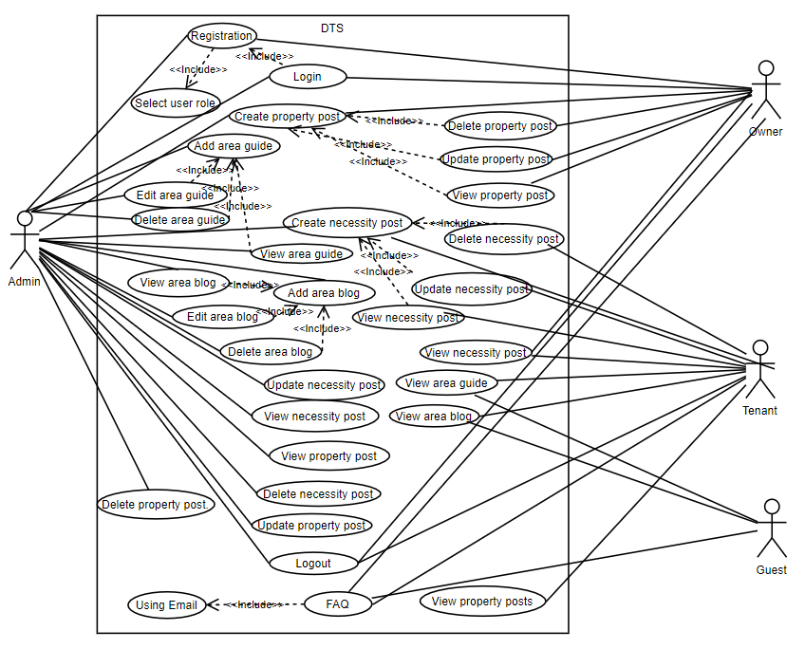
Use case Diagram:

Slide 8
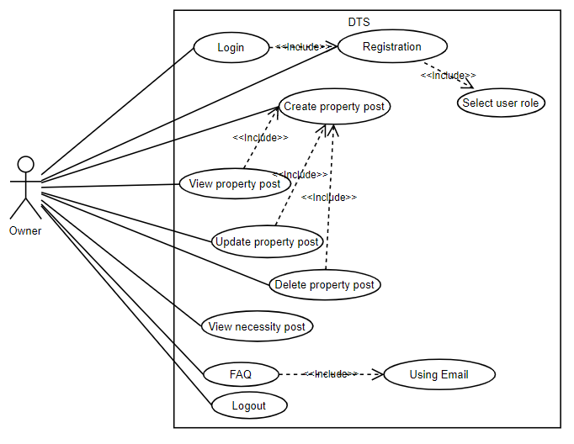
Use case Diagram for Owner:

Slide 9
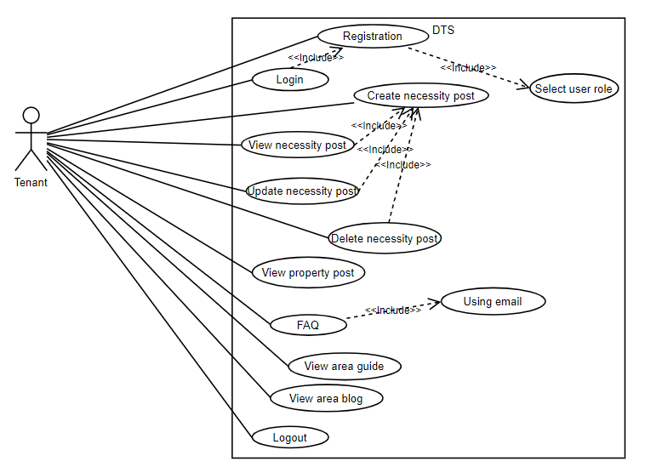
Use case Diagram for Tenant:

Slide 10
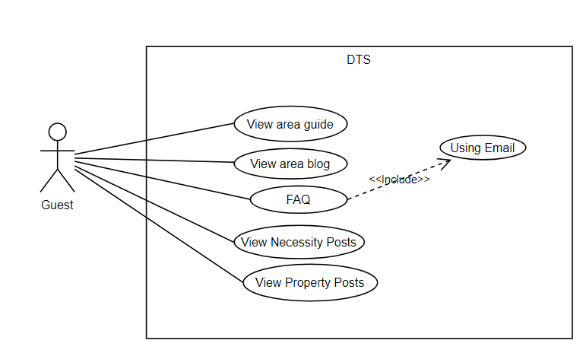
Use case Diagram for Guest:

Slide 11
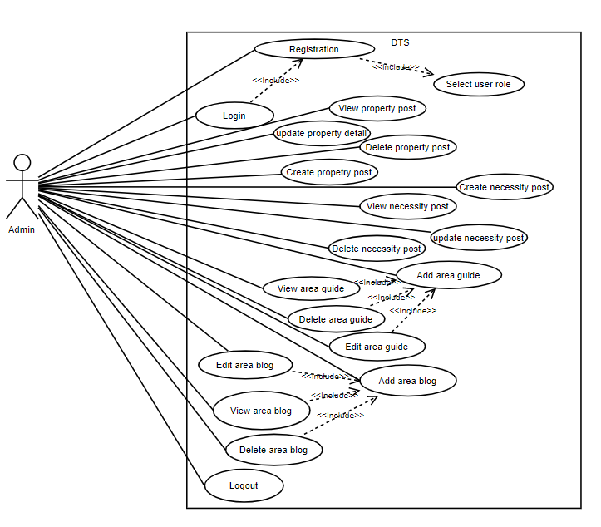
Use case Diagram for Admin:

Slide 12
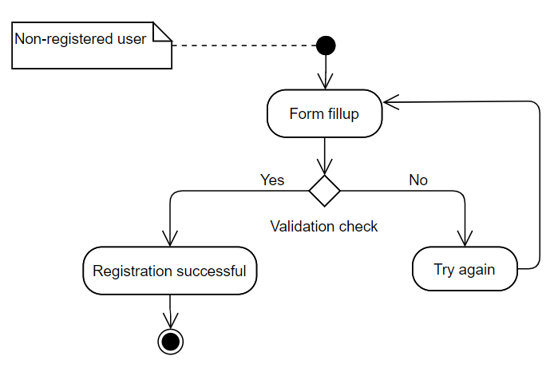
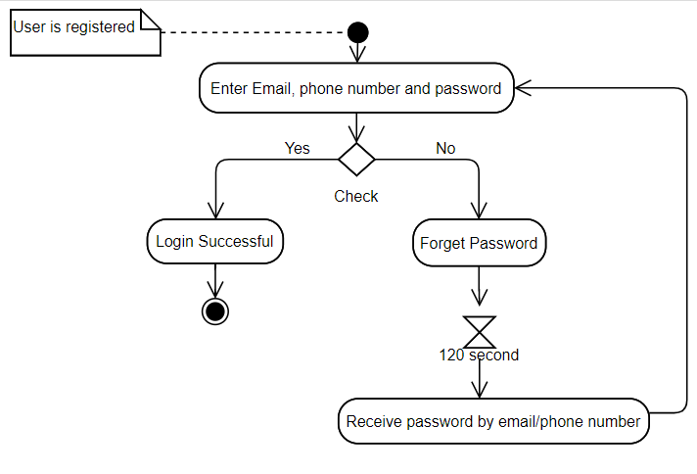
Activity Diagram :
Registration
Login

Slide 13
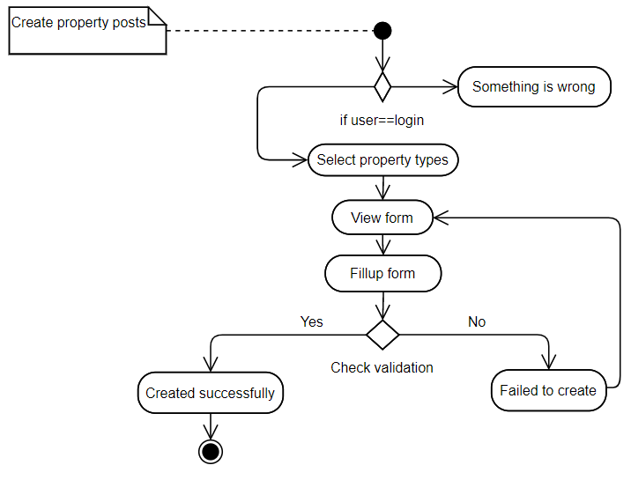
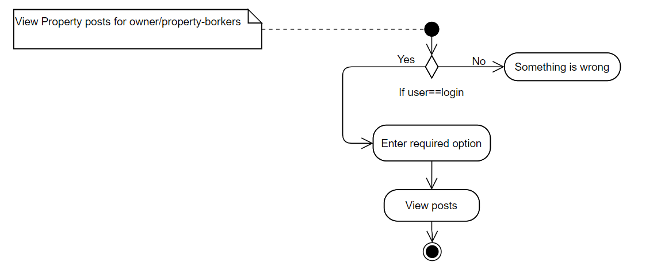
Activity Diagram (Cont…):
Create property posts
View property posts for owner/admin

Slide 14
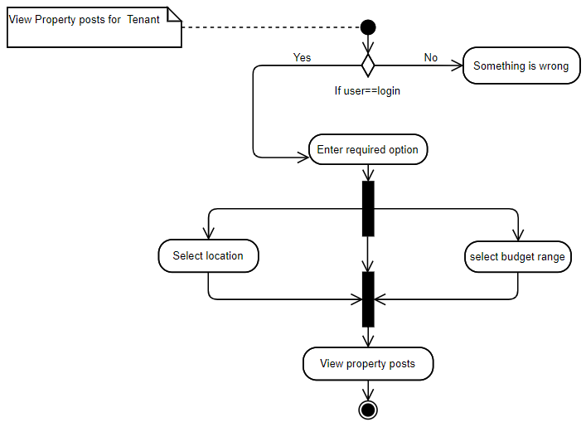
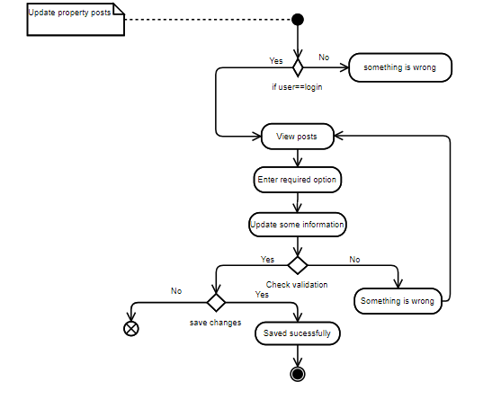
Activity Diagram (Cont…):
View property posts for Tenant
Update property posts

Slide 15
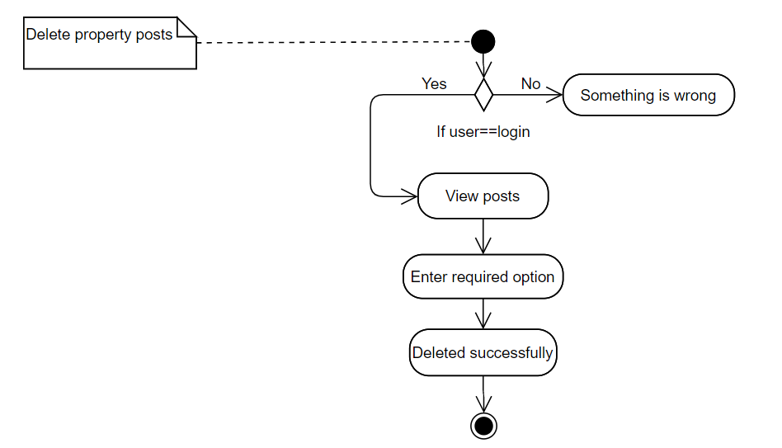
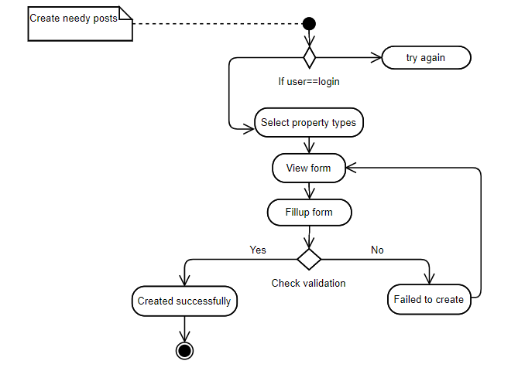
Activity Diagram (Cont…):
yes
no
Delete property posts
Create needy posts

Slide 16
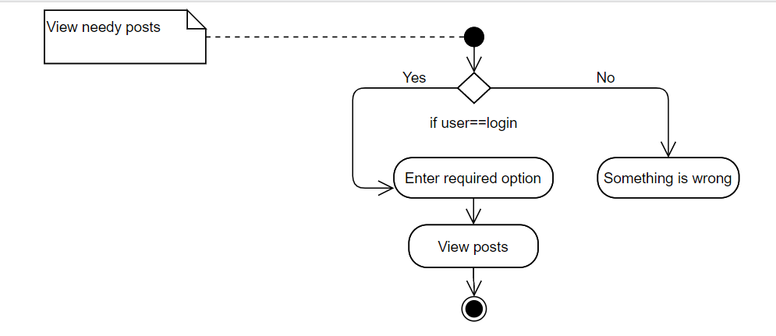
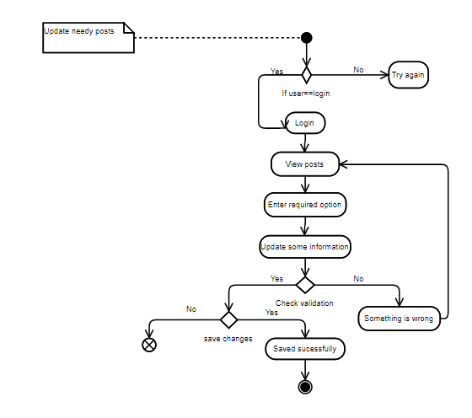
Activity Diagram (Cont…):
View needy posts
Update needy posts

Slide 17
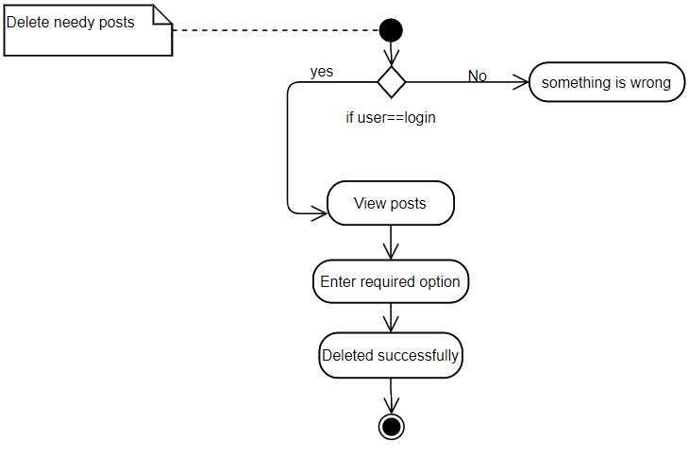
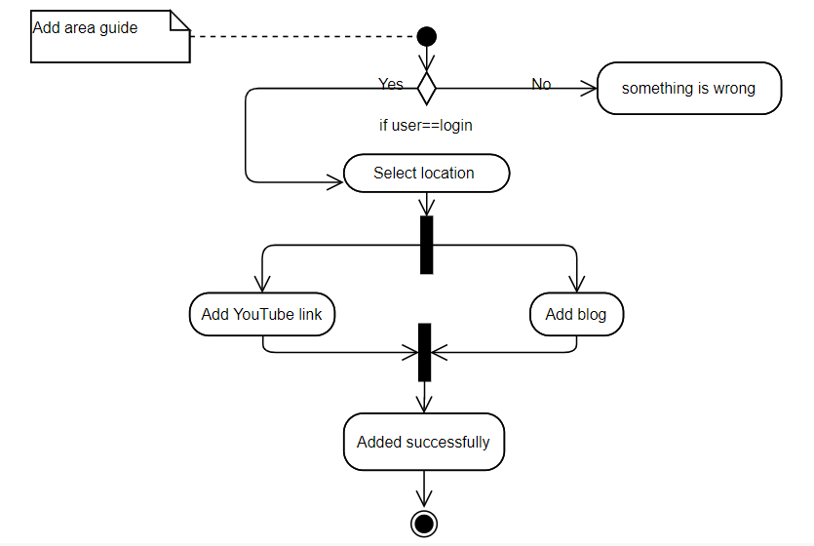
Activity Diagram (Cont…):
Delete needy posts
Add area guide

Slide 18
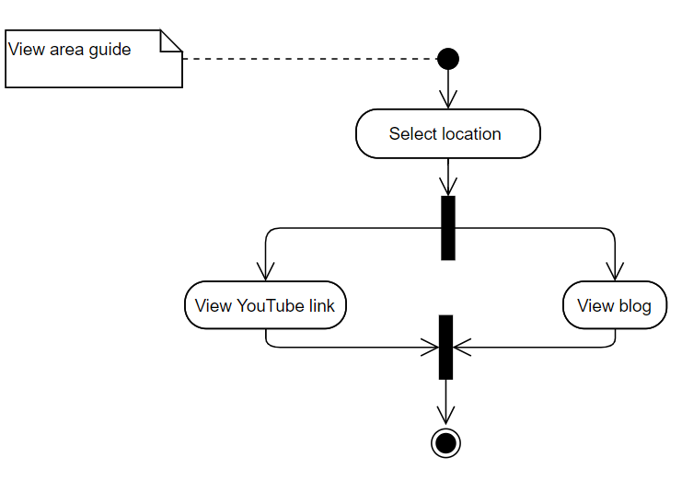
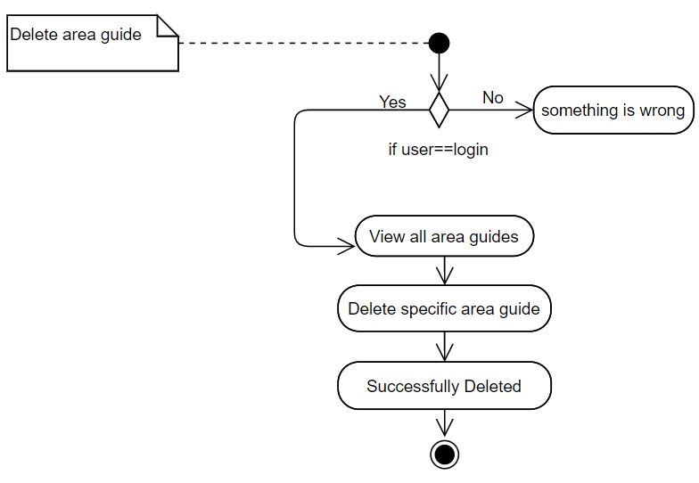
Activity Diagram (Cont…):
View area guide
Delete area guide

Slide 19
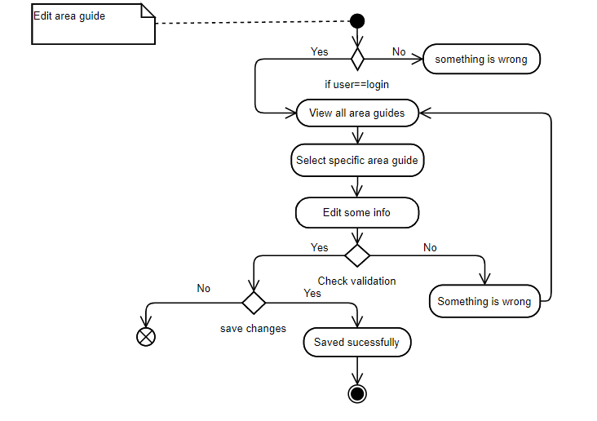
Activity Diagram (Cont…):
Edit area guide

Slide 20
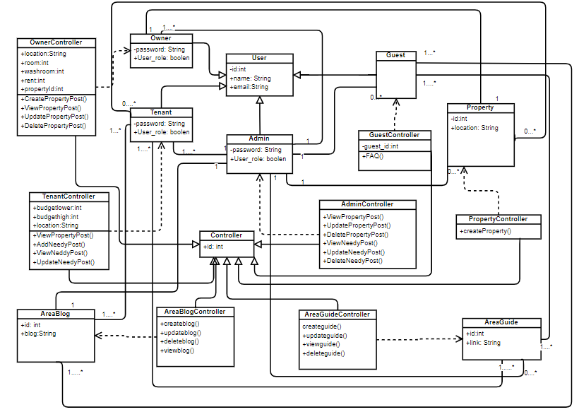
Class diagram:

Slide 21
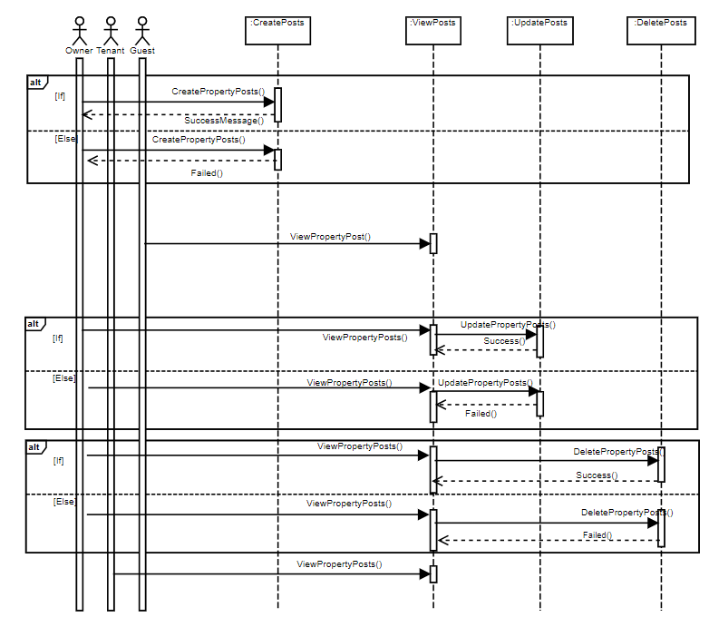
Sequence diagram:
Property Issue for Owner, Tenant and Guest

Slide 22
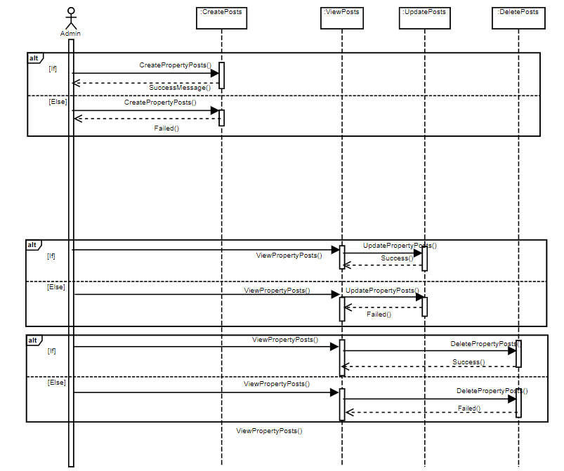
Sequence diagram:
Property Issue for Admin

Slide 23
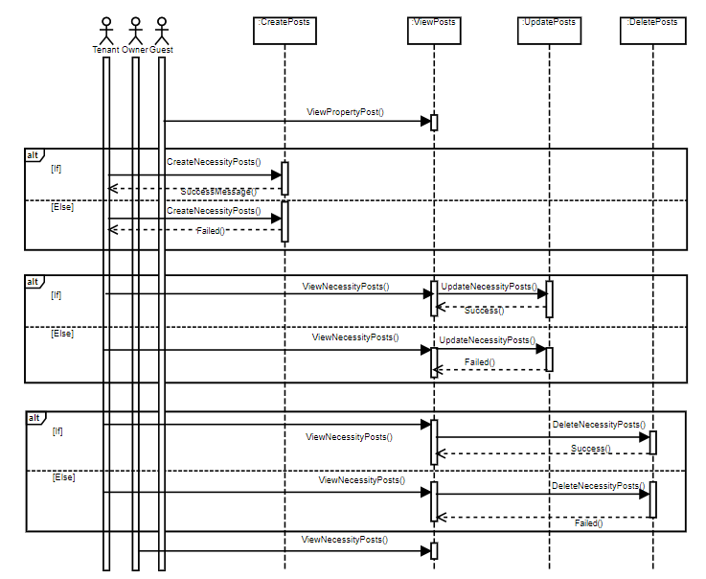
Sequence diagram:
Necessity Issue for Owner, Tenant and Guest

Slide 24
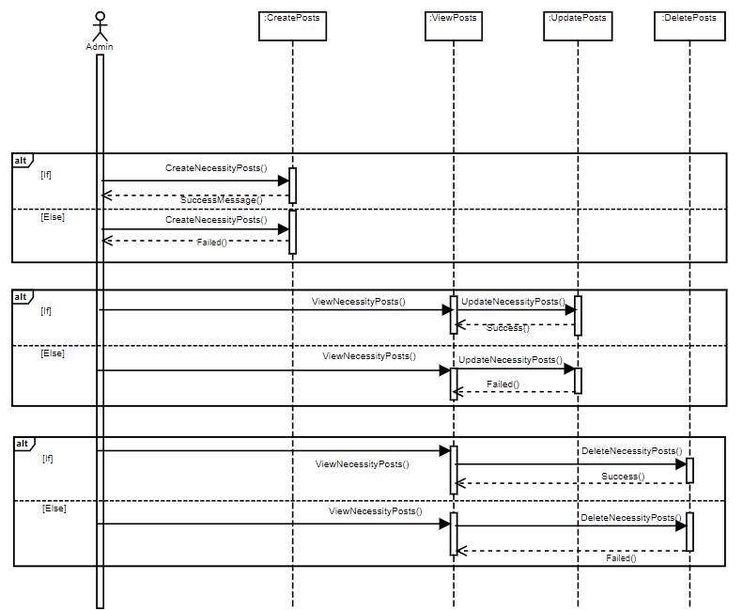
Sequence diagram:
Property Issue for Admin

Slide 25
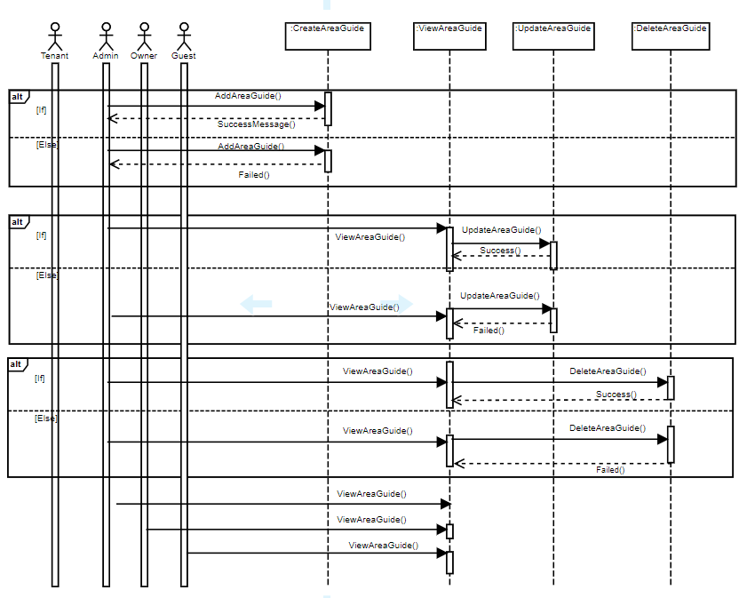
Sequence diagram:
Area Guide Issue

Slide 26
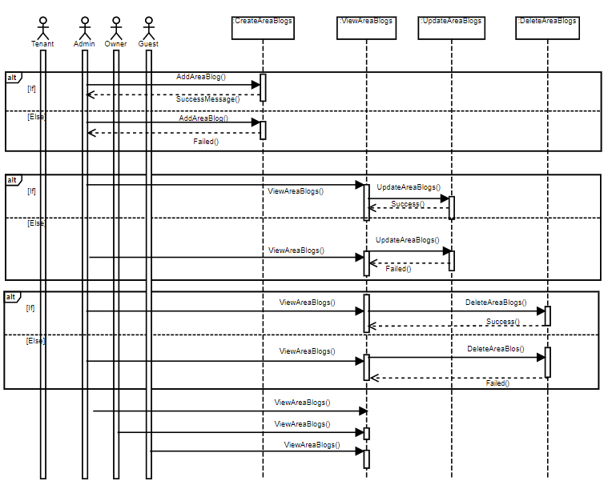
Sequence diagram:
Area Blog Issue

Slide 27
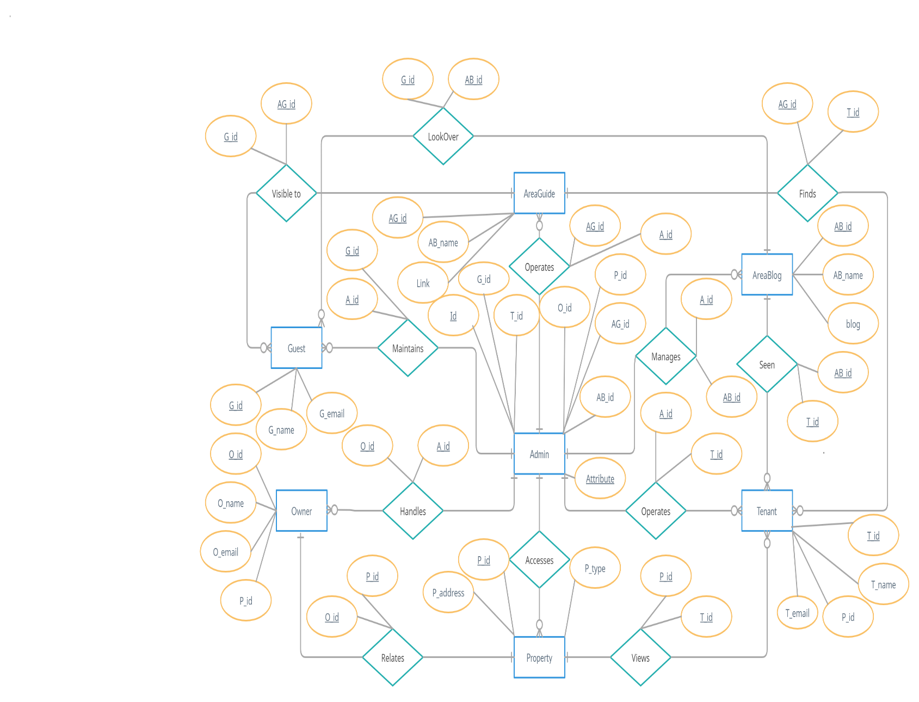
ER Diagram

Slide 28
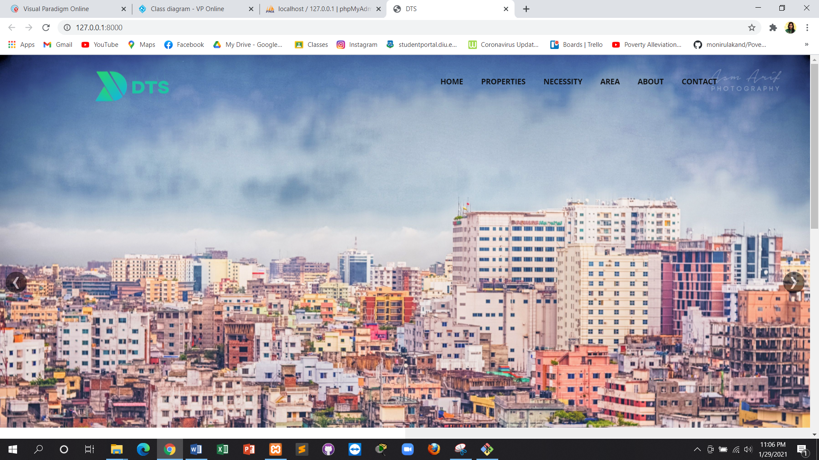
Screenshot for Home Page:

Slide 29
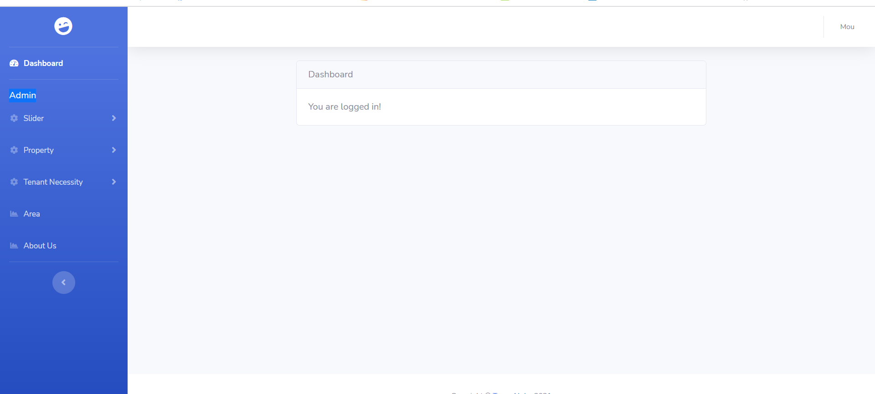
Screenshot for Admin Dashboard Page:

Slide 30

Screenshot for Owner Dashboard Page:

Slide 31

Screenshot for Tenant Dashboard Page:

Slide 32
Technology:
HTML & CSS
Laravel framework
Bootstrap
PHP
javascript
MySQL Database

Slide 33


Slide 34
Thank you all

